Slide 1
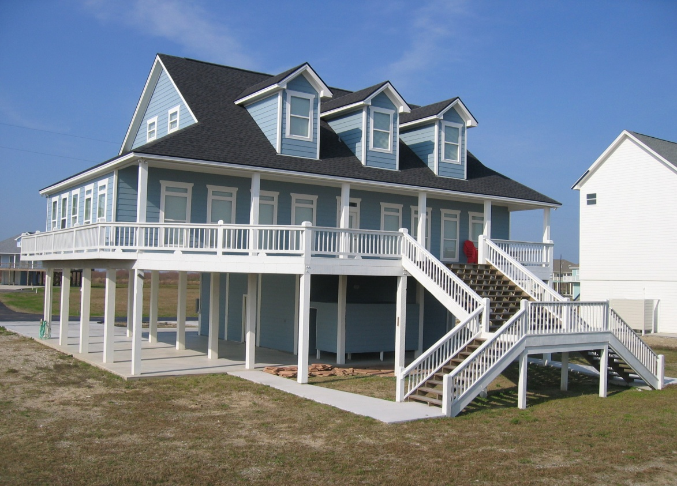
Post-Disaster Rebuilding for Pinellas County April 7th, 2011
Josette Severyn
Blake Harvey
Sekita Grant
Brett Lackey
Alex Fisher
Hilary Flint
Amy Long
Image source: Accent Beach Homes

Slide 2
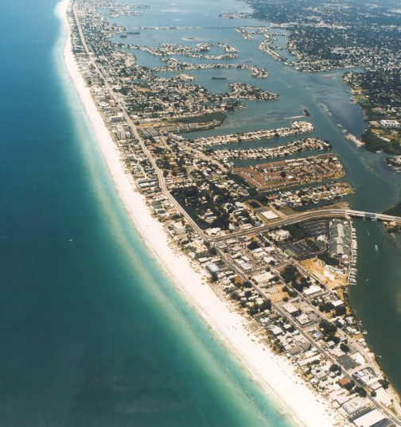
Outline
Purpose
Ordinance Content
Zoning
Post-disaster Recovery
Historic Preservation
Process
Questions
Image source: Beach to Bay Realty

Slide 3
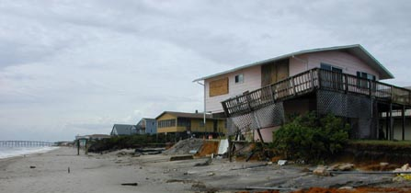
Purpose of Post Disaster Redevelopment Plan (PDRP)
To reduce or eliminate the exposure of human life and public and private property to natural hazards
Image source: FEMA

Slide 4
Purpose of Ordinance
1. To set forth options managing changes in developing rights after sands have shifted and regulate post-disaster build-back
2. To prescribe regulations for coastal high hazard and flood hazard areas
3. To encourage the flood proofing of all structures

Slide 5
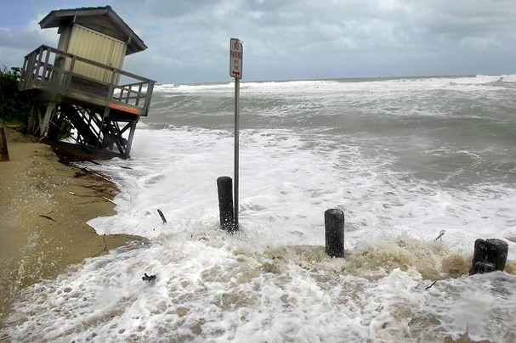
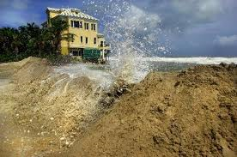
Zoning
Property lines will be redefined according to federal, state and local laws, in the event a natural disaster permanently changes the mean high water line (MHWL)
Image source: Tcpalm.com

Slide 6
Zoning-Loss of Land
If loss of land occurs, the Pinellas County Board of Commissioners has the discretion to choose any of the following responses, or any combination thereof:
Active Role of Municipality
Transfer of Development Rights (TDR’s)
Land Swap
Mediation (Burt J. Harris Act)
Passive Role of Municipality
Heightened notice requirements: disclosure of risks to potential buyers of coastal land
Heightened environmental requirements for coastal property ownership
specify minimum dune height and width requirements

Slide 7
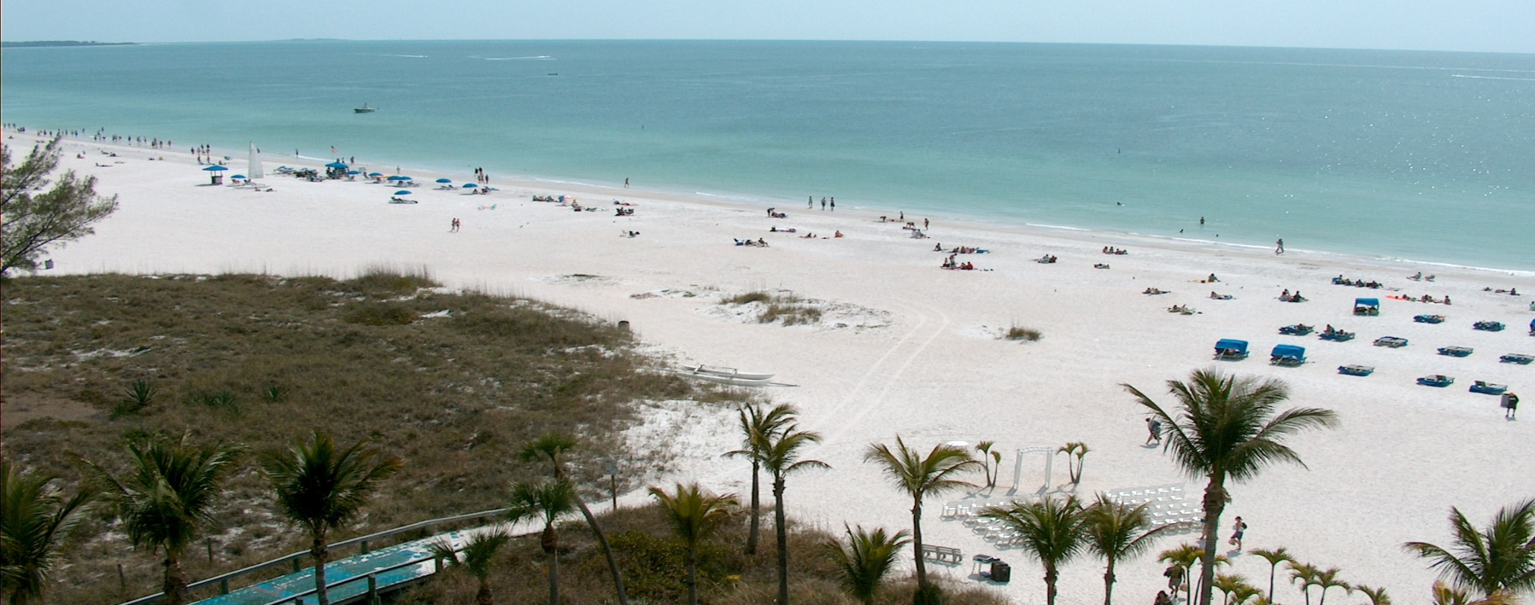
Zoning- Public Easements
Public easements will remain intact by shifting the easement line inland
Image source: Panoramio.com

Slide 8
Post-Disaster Recovery Period
Begins immediately following a natural disaster or immediately following a moratorium
Ends 90 days after it begins
Image source: beachrebuilder.com

Slide 9
Post-Disaster Recovery Preliminary Studies
The Pinellas County Public Works Department, the Office of Emergency Management, and the Planning Department shall:
Identify (1) damaged areas requiring rehabilitation or redevelopment and (2) high-risk areas for development;
Analyze and recommend hazard mitigation options for the redevelopment of damaged areas and public facilities; and
Recommend amendments, if needed, to the Pinellas County Comprehensive Development Master Plan.

Slide 10
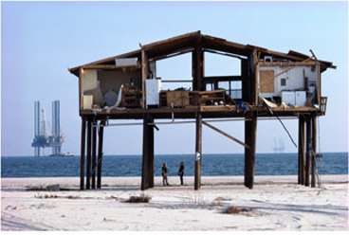
Post-Disaster Recovery “V” Zone
Damage exceeding 50 percent of pre-storm market value, if reconstructed, shall comply with the Coastal High Hazard Area (“CHHA”) section of the Florida Building Code and Chapter 158 of the Pinellas County Code
Image source: Freelance-help.com

Slide 11
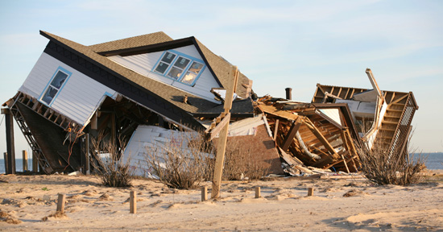
Post-Disaster Recovery Recurring Destruction
Structures which have suffered damage to pilings, foundations, or load bearing walls more than one time within a 3 year period shall rebuild landward of their present location and be structurally modified to meet current building codes.
Image source: The Storm Resource

Slide 12
Post-Disaster Recovery Permitting Process
The permitting process shall be temporarily modified to provide for rapid disaster repairs and accelerate safe redevelopment of critical facilities within the County
Critical facilities shall receive primary focus
Permitting standards will be relaxed to require one permit and one inspection to allow for rapid redevelopment
The permitting for minor repairs shall be expedited

Slide 13
Historic Preservation
Ensure debris clearance and repairs do not undermine historic resources
Recover and reuse existing materials from historic structures to retain as historic integrity and aesthetics of the structure

Slide 14
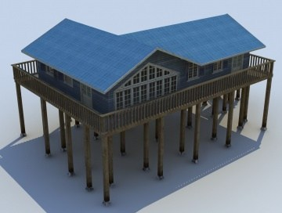
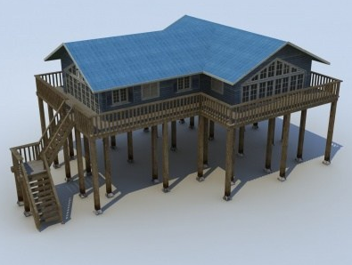
Process
If ordinance creates an unnecessary hardship or inequity to an individual landowner, such owner may seek, through the Board of Adjustment, a variance or special exception.
Image source: Cornucopia3D

Slide 15
Summary
Purpose – to reduce exposure to natural hazards through:
Zoning – Redefine property lines
Post-disaster Recovery – 90 day period
Historic Preservation – Maintain historic integrity
Process – Variances and special exceptions

Slide 16
Questions
Image source: Travelbysimon.net

