Slide 1
2060 Regional Growth Scenarios for East-Central Florida
By Blake Harvey

Slide 2
Project Description
A projection of future urban growth and development to 2060 in Brevard, Seminole, Volusia and Orange Counties

Slide 3
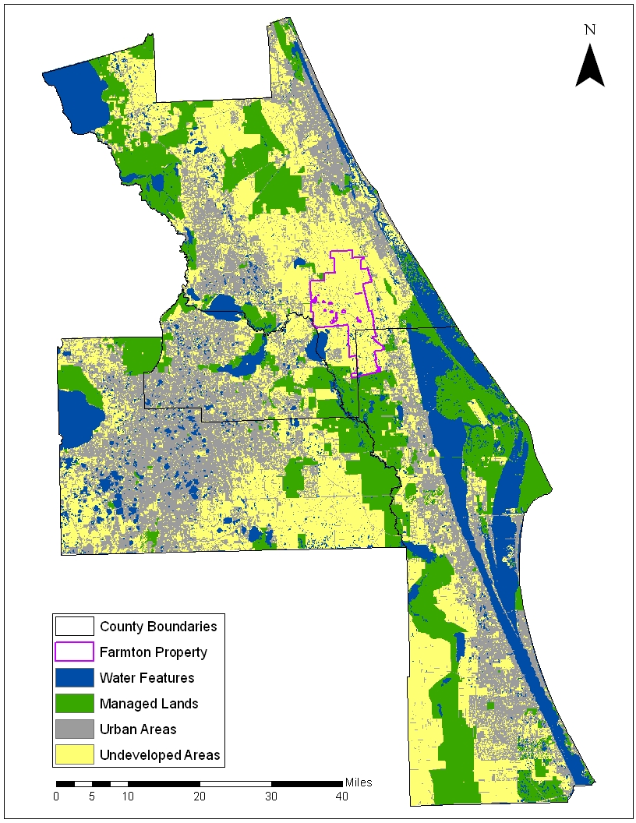
Population Allocation Methodolgy
Determine land uses unlikely to change
Conservation Lands
Open Water
Existing Urban Development
Inundated Lands (in SLR scenarios)

Slide 4
Population Projections
Determine new population to be added in four county region between 2010 and 2060
In SLR scenarios, add to this the population on land that will be displaced (assuming 100% stay in the study area)
Allocate some percentage to redevelopment in existing urban areas – the rest will be allocated to projected new development

Slide 5
Determine Gross Urban Density
To determine new development density, the existing Gross Urban Density must first be calculated
First, the Gross Urban Area is calculated – in our scenarios, this was done with tax parcel data
Parcel classes that were determined to have urban structures, along with transportation networks, were considered the Gross Urban Area
This was then divided by the current population of the study area, for 5.406 people per acre

Slide 6
Model Assumptions
Three Scenarios were used:
Low-Density “Trend” Scenario
Low-Density Development/Sea Level Rise
High-Density Development/Sea Level Rise
 | Population to Allocate |  | Percent of New Population in Redevelopment |  | New Development Density |  | Available for Development |  | Not Available for Development
Trend Scenario | 2,523,310 |  | 0% |  | 5.406 People per Acre |  | Greenfield (Undeveloped) Lands, |  | Managed Lands, Transportation Networks, Water
2-Meter Sea Level Rise - Low Density | 2,005,077 |  | 25% |  | 5.406 People per Acre |  | Greenfield (Undeveloped) Lands, |  | Managed Lands, Transportation Networks, Water, Inundated Lands
2-Meter Sea Level Rise - High Density | 1,791,202 |  | 33% |  | 6.757 People per Acre |  | Greenfield (Undeveloped) Lands, |  | Managed Lands, Transportation Networks, Water, Inundated Lands

Slide 7
Methodology
For sea level-rise scenarios, displaced population was calculated using 2-meter SLR models and census data, and this was added to the 2060 population growth, as population to allocate
All lands other than those for which the uses are not likely to change were considered developable “greenfield”
The amount of land projected to be developed (in acres) was calculated by dividing population growth by development density

Slide 8
Methodology Continued
Population was allocated to specific acreage based on: “Developability” (greenfield), least land use conflict, and urban suitability
The level of urban suitability was used as a “threshold”

Slide 9
High Urban Preference/No Conflict
Urban Suitability

Slide 10
Results
1. Low-Density “Trend” Scenario
2. Low-Density Development/Sea Level Rise
3. High-Density Development/Sea Level Rise

Slide 11
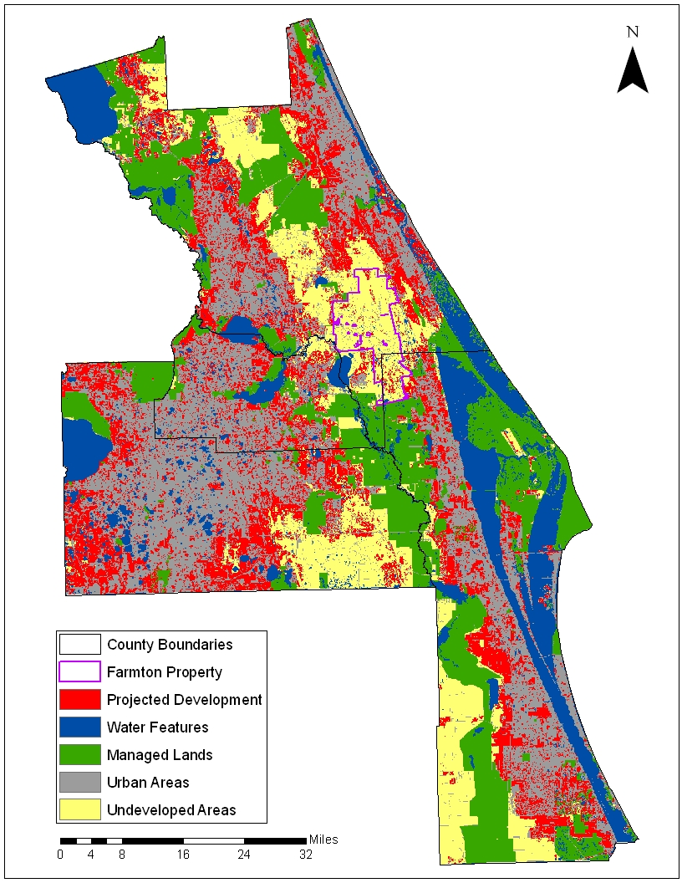
Low-Density “Trend”
Development Density: 5.406 People per Acre
Acres Projected for New Development: 494,812
Population Allocated to New Development: 2,674,958
Selection Criteria: Conflict 13, 12, 22, 23, 33, Urban Suitability over 265

Slide 12
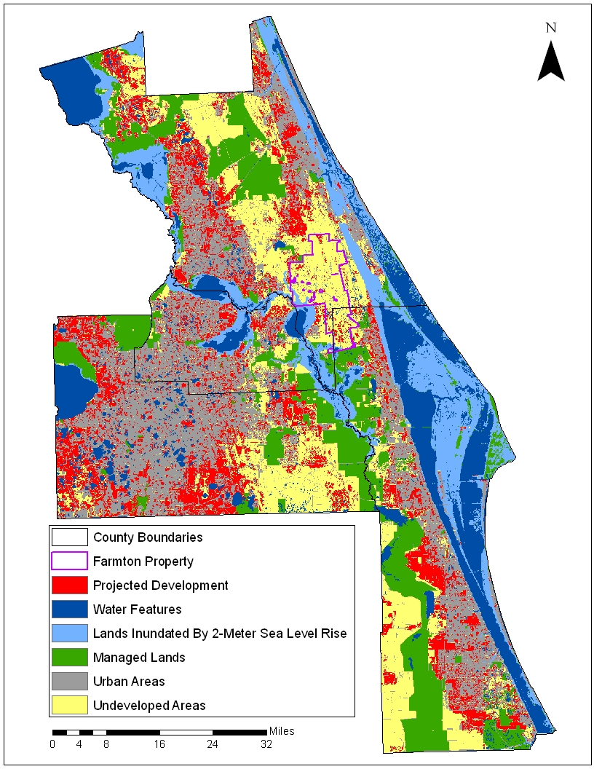
Low-Density/Sea Level Rise
Development Density: 5.406 People per Acre
Acres Projected for New Development: 370,801
Population Allocated to New Development: 2,004,527
Selection Criteria: Conflict 13, 12, 22, 23 Urban Suitability over 260

Slide 13
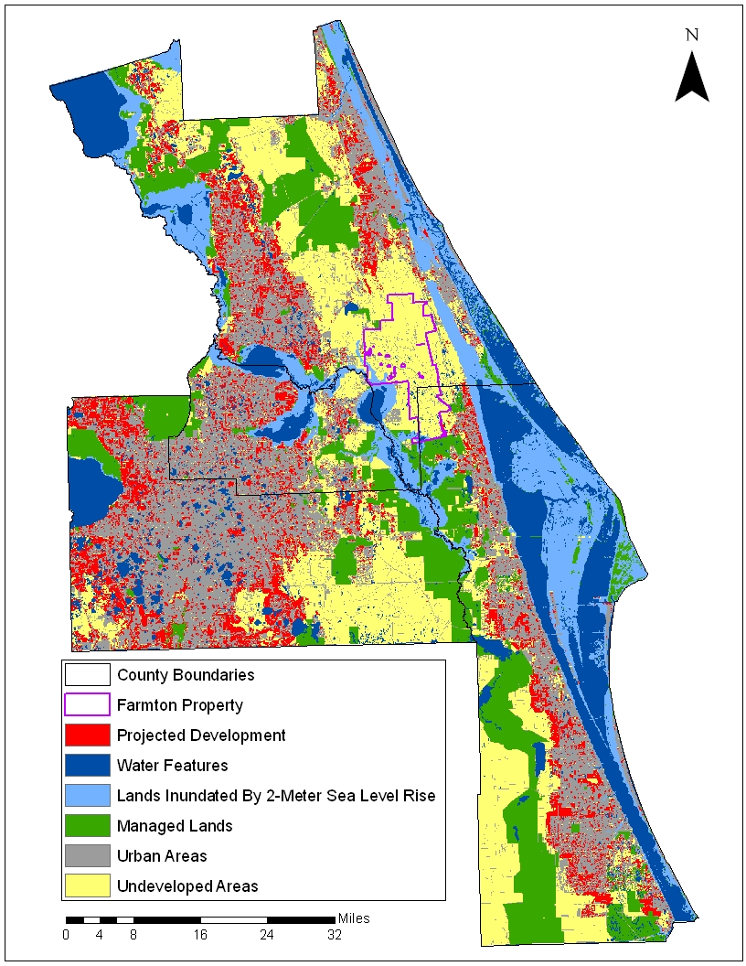
High-Density/Sea Level Rise
Development Density: 6.757 People per Acre
Acres Projected for New Development: 266,007
Population Allocated to New Development: 1,797,423
Selection Criteria: Conflict 13, 12, 23, Urban Suitability over 335

Slide 14
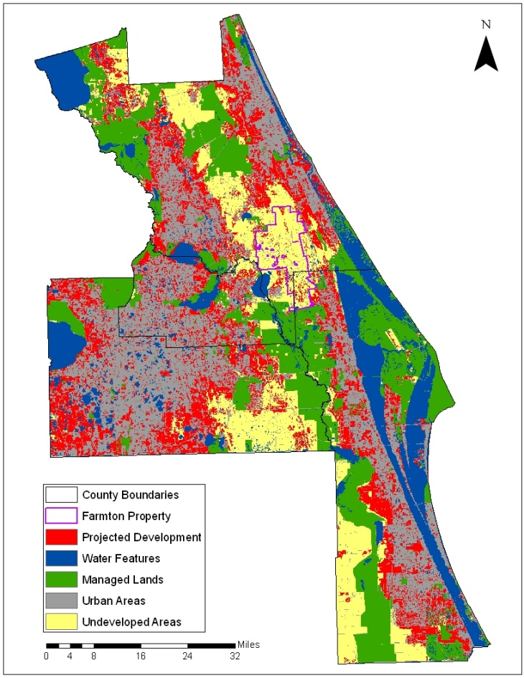
Trend
Low Density/SLR
High Density/SLR

